Slide 1


1Z Inc.
Home
About
Content
Others
Computer
HARDWARE & SOFTWARE
SIATON, CHARLES ANDRE

Slide 2



1Z Inc.
Home
About
Content
Others
agenda
We will discuss the following topics in this presentation:
> Hardware
> Software
> Implementation

Slide 3
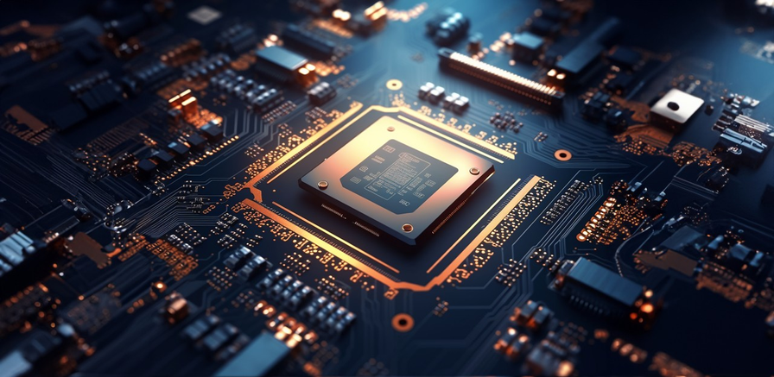
1Z Inc.
Home
About
Content
Others
WHAT IS HARDWARE?
Computer hardware is seen as a collection of resources. Performance, functional capabilities, and quantity of these resources are decisive to overall system performance. Starting from this paradigm, computer architecture design may be handled systematically in the future even by formalized methods (Matthes, 1990).
HARDWARE

Slide 4
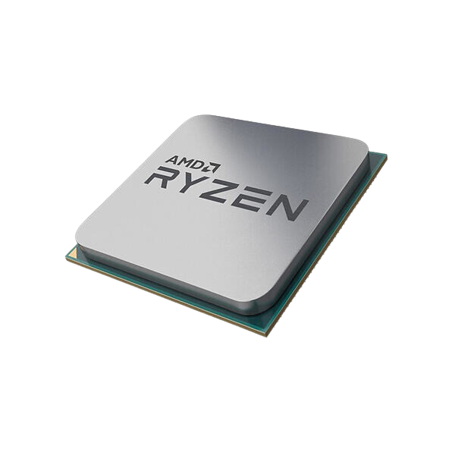
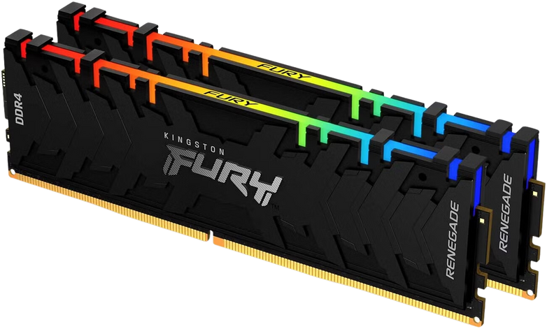
1Z Inc.
Home
About
Content
Others
A basic overview of computer hardware relevant to radiology practice is presented here. The key hardware components in a computer are the motherboard, central processor unit (CPU), the chipset, the random access memory (RAM), the memory modules, bus, storage drives, and ports. The personnel computer (PC) has a rectangular case that contains important components called hardware, many of which are integrated circuits (ICs). The fiberglass motherboard is the main printed circuit board and has a variety of important hardware mounted on it, which are connected by electrical pathways called “buses”. The CPU is the largest IC on the motherboard and contains millions of transistors. Its principal function is to execute “programs”. A Pentium® 4 CPU has transistors that execute a billion instructions per second. The chipset is completely different from the CPU in design and function; it controls data and interaction of buses between the motherboard and the CPU. Memory (RAM) is fundamentally semiconductor chips storing data and instructions for access by a CPU. RAM is classified by storage capacity, access speed, data rate, and configuration (Indrajit & Alam, 2010) .

Slide 5
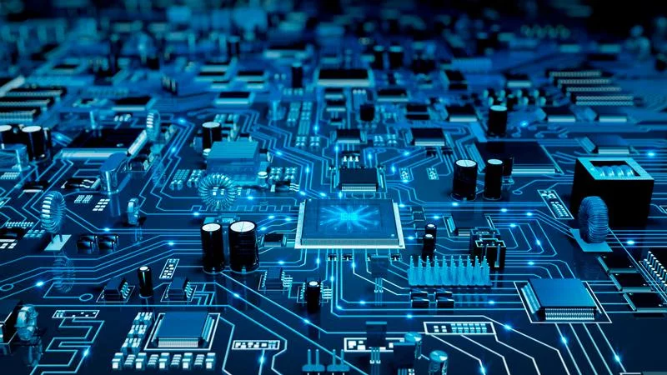
1Z Inc.
Home
About
Content
Others
WHAT IS HARDWARE?
According to Saputra et al. (2018), computer hardware refers to the physical components of a computer that are used to process, store, and transmit information. This includes components like the processor, motherboard, RAM, hard drive, and graphics card that work together to perform various computing tasks.
HARDWARE

Slide 6
1Z Inc.
Home
About
Content
Others
ACCORDING TO INDRAJIT AND ALAM (2010B),
THESE ARE THE ESSENTIAL COMPONENTS OF COMPUTER STORAGE AND CONNECTIVITY.

Slide 7
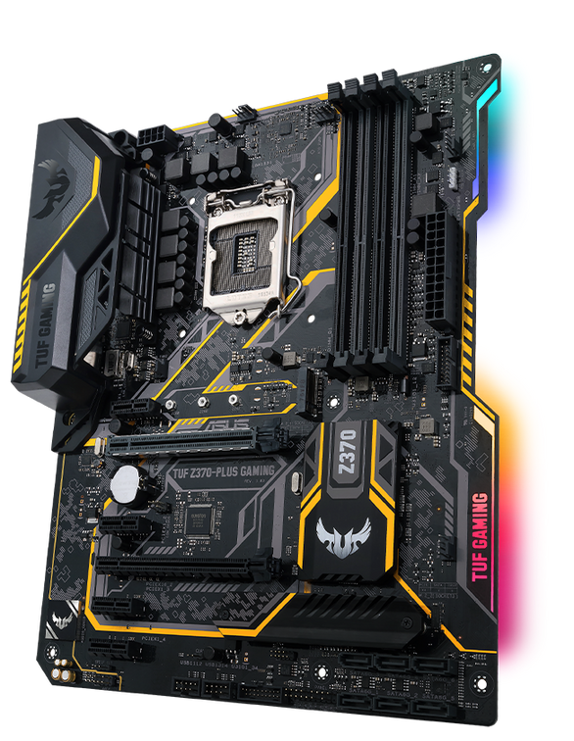
1Z Inc.
Home
About
Content
Others
MOTHERBOARD
The main circuit board that connects all computer components and provides a central point for data communication.
Houses the CPU, memory, and expansion slots for adapter cards, allowing the integration of additional functionalities.

Slide 8
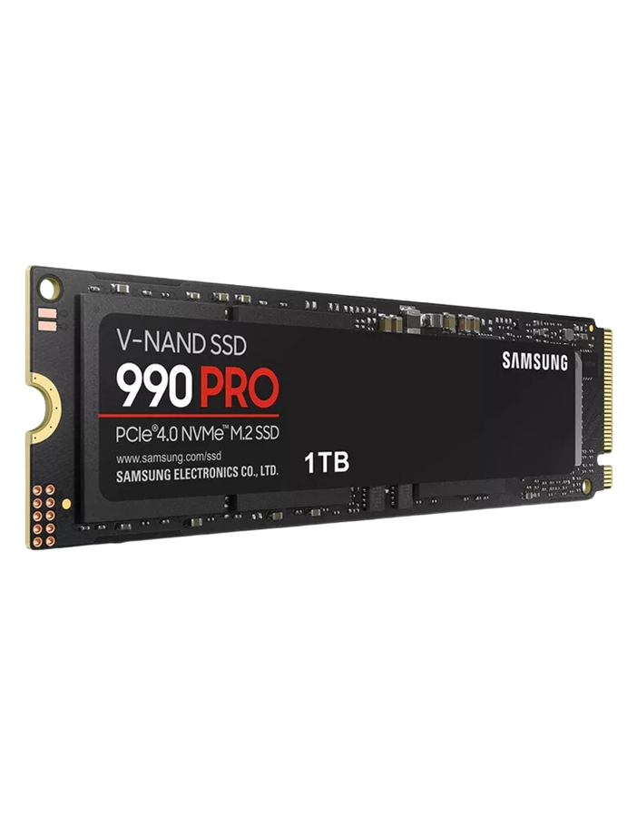
1Z Inc.
Home
About
Content
Others
STORAGE DRIVES
Used to store and retrieve various types of data, such as text, images, audio, and video files.
Common types include hard drives for primary storage, flash drives for portability, and optical drives for CDs/DVDs.

Slide 9
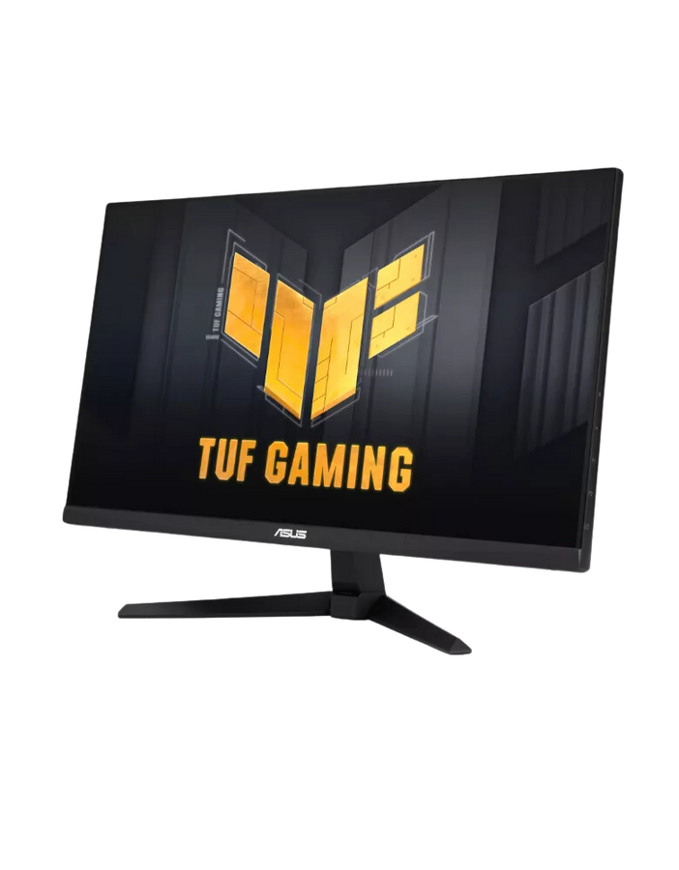
1Z Inc.
Home
About
Content
Others
INPUT & OUTPUT DEVICES
Essential for user interaction with the computer, including monitors for display, keyboards for typing, mice for navigation, and printers for output.
Adapter cards can expand capabilities by adding functions like sound, network, or video processing.

Slide 10
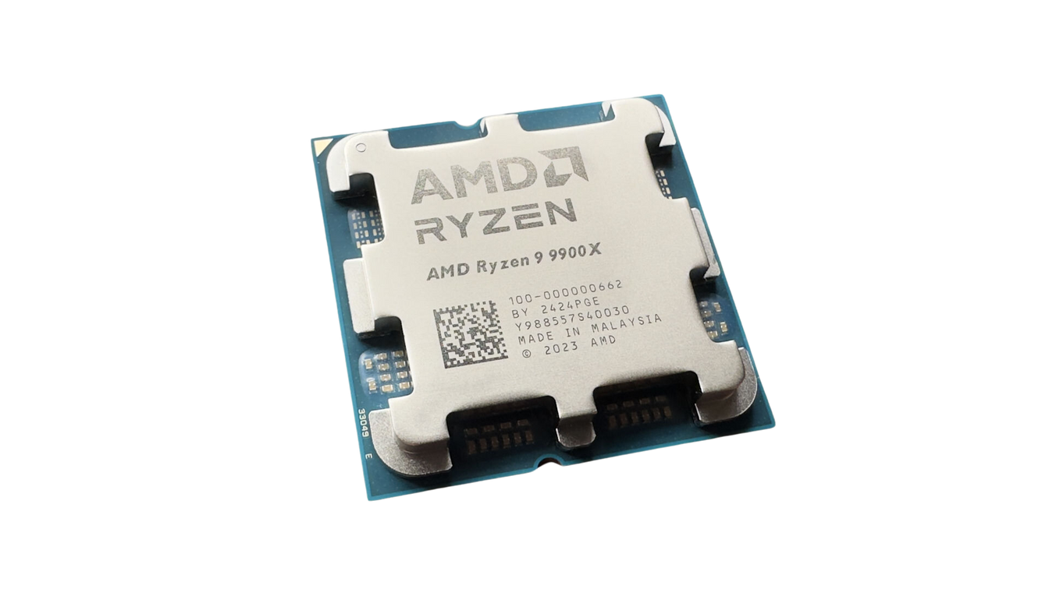
1Z Inc.
Home
About
Content
Others
PROCESSOR (CPU)
Acts as the "brain" of the computer, executing instructions, performing calculations, and processing data.
Includes types like Intel Core for general use, Xeon for servers, and Atom for mobile and lightweight devices.

Slide 11
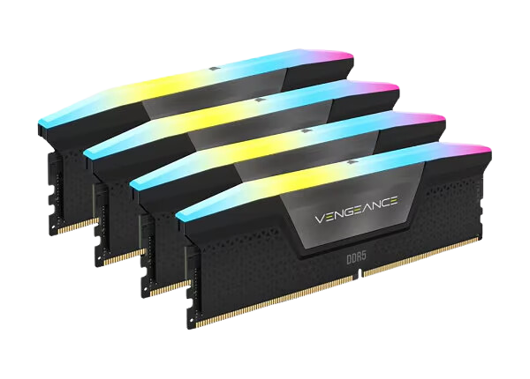
1Z Inc.
Home
About
Content
Others
MEMORY (RAM)
Provides temporary storage to hold data for active applications and processes.
Helps speed up data access, contributing to smoother and faster performance for multitasking.

Slide 12
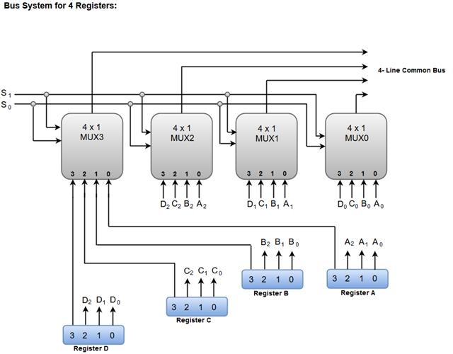
1Z Inc.
Home
About
Content
Others
DATA TRANSFER BUSES
Buses serve as data transfer pathways within the computer, allowing communication between components.
Types include system buses for core functions and PCI Express, PCI, and AGP buses for connecting additional hardware.

Slide 13
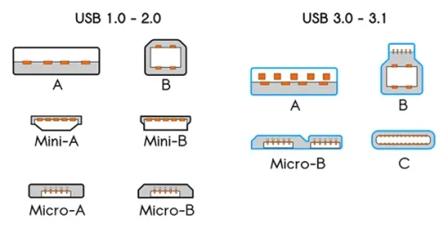
1Z Inc.
Home
About
Content
Others
PORTS
Connect external devices to the computer, such as USB for a wide range of peripherals, LAN for networking, and audio/video ports for sound and display devices.
USB ports are especially versatile, supporting many types of devices like external drives, printers, and more.

Slide 14
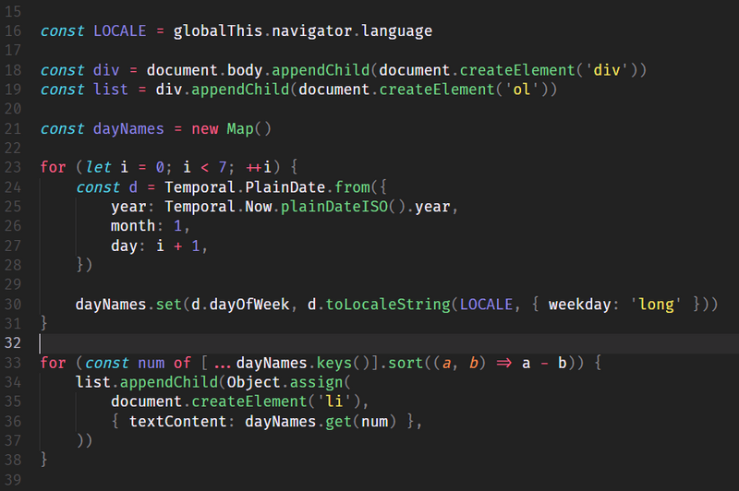
1Z Inc,
Home
About
Content
Others
SOFTWARE
Computer software refers to the digital data, including programs, documentation, and other information, that is stored and executed by a computer, as the intangible part of a computer system in contrast to the physical hardware (Sarkar, 2023).

Slide 15
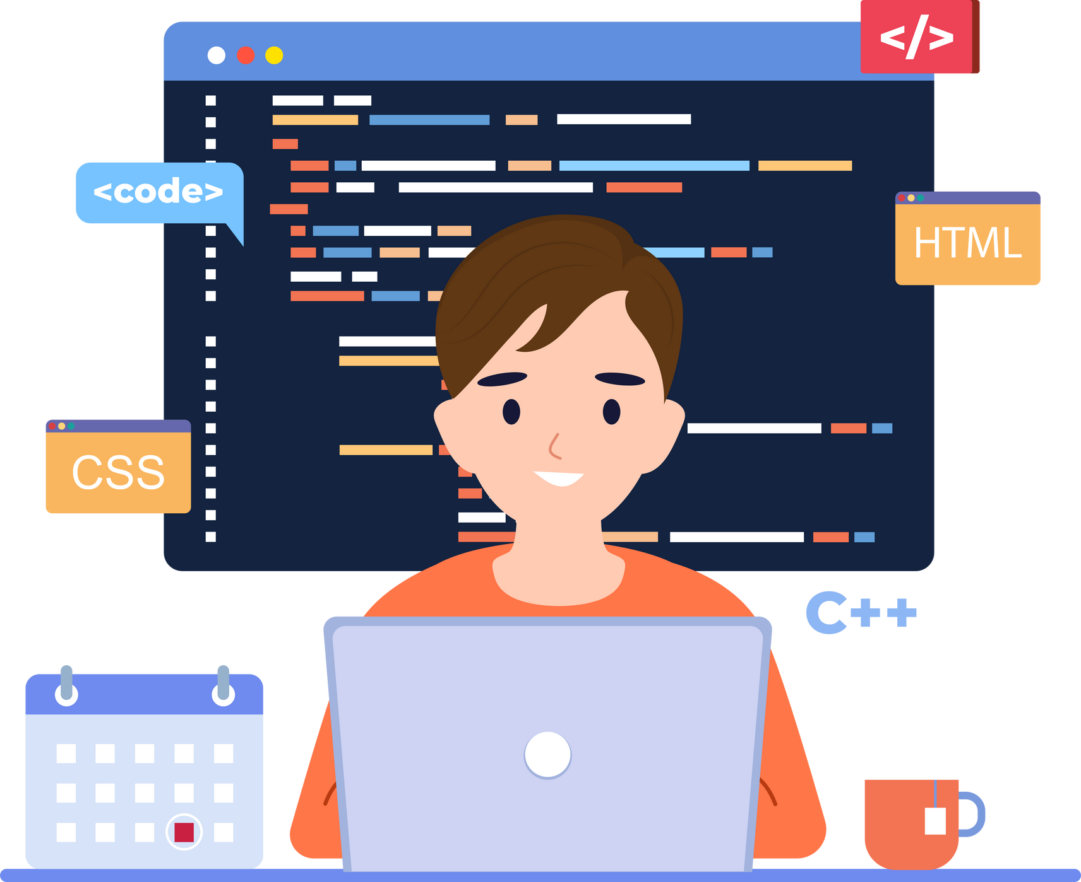
1Z Inc,
Home
About
Content
Others
Computer software is a set of programs that control the operation of a computer or automated system. The history of software development is closely tied to the development of computers, and is reflected in the user-computer interface that allows interaction between devices, programs, and people. Early computer programming was done directly in machine code, but with the advent of personal computers, mass users were able to get closer to computing resources without needing to interact directly with the hardware (Akhmedov, 2022).

Slide 16
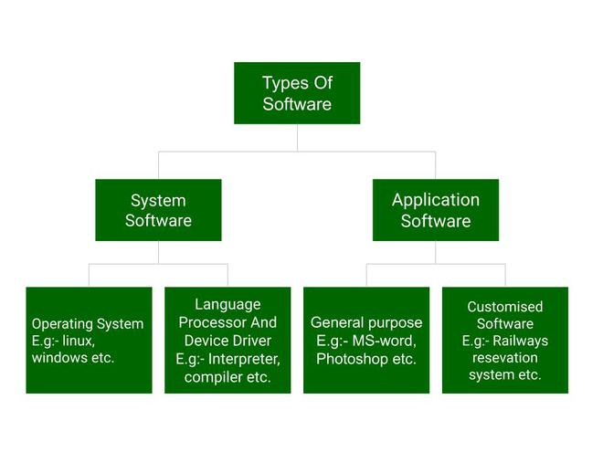
1Z Inc,
Home
About
Content
Others
TYPES OF SOFTWARE
ACCORDING TO BELADY (1995)
1) Software components integrated into a wide range of non-computer products and services, beyond just specialized "software factories"
2) Software that must be designed, built, tested, and operated as part of a system of both computer and non-computer parts
3) Software that requires expertise not just in information processing, but also in the specific industry and application domain

Slide 17
1Z Inc,
Home
About
Content
Others
WORKING OF SOFTWARE
ACCORDING TO AKHMEDOV (2022B)
1. Early software development focused on machine code programming where users directly managed computer resources.
2. The introduction of operating systems in the 1940s-1950s enabled batch processing and the use of high-level programming languages like Fortran, reducing the burden on users.
3. The development of user interfaces and shells like MS Windows further abstracted the hardware components and provided a more logical and graphical interface for users to interact with computer resources.

Slide 18
1Z Inc,
Home
About
Content
Others
RELATIONSHIP BETWEEN HARDWARE AND SOFTWARE
ACCORDING TO RANDELL (1985)
Hardware and software are logically equivalent. Any operation performed by software can also be built directly into the hardware and any instruction executed by the hardware can also be simulated in software. The decision to put certain features in hardware and others in software is based on such factors as cost, speed, reliability and frequency of change. There are no hard and fast rules to the effect that X must go into the hardware and Y must be programmed explicitly. Designers with different goals may, and often do, make different decisions... the boundary between hardware and software is arbitrary and constantly changing. Today's software is tomorrow's hardware, and vice versa.

Slide 19
1Z, Inc.
Home
About
Content
Others
IMPLEMENTATION
Computers are essential in various sectors, enhancing efficiency, service quality, and communication. From education and healthcare to finance and government, they streamline operations, support data management, and enable innovation, driving community development and improved daily life.

Slide 20
1Z, Inc.
Home
About
Content
Others
1. Education:
Computers enable online learning, virtual classrooms, digital libraries, and efficient student record management.
2. Healthcare:
Used for electronic health records, telemedicine, and medical imaging, enhancing patient care and diagnostics.
3. Banking & Finance:
Computers support online banking, fraud detection, and data analytics for personalized services.
4. Government & Public Services:
Enable e-government services, data collection, public safety, and statistical analysis for informed policymaking.
5. Retail & E-commerce:
Assist with inventory tracking, customer relationship management, and point-of-sale systems to streamline operations.
6. Transportation & Logistics:
Facilitate GPS navigation, reservation systems, and supply chain management for optimized logistics.

Slide 21
1Z, Inc.
Home
About
Content
Others
6. Transportation & Logistics:
Facilitate GPS navigation, reservation systems, and supply chain management for optimized logistics.
7. Agriculture:
Used in precision farming, automated machinery, and agribusiness supply chains to improve efficiency.
8. Manufacturing & Industry:
Control automation, ensure quality control, and aid in product design through CAD software.
9. Entertainment & Media:
Essential for creating digital content, streaming services, and interactive media like gaming and virtual reality.
10. Science & Research:
Enable data analysis, simulations, lab automation, and global collaboration in scientific research.
11. Energy & Utilities:
Help manage smart grids, renewable energy systems, and environmental monitoring for sustainability.
12. Hospitality & Tourism:
Support booking systems, customer service, and event management, improving service and convenience in travel.

Slide 22
Wardiere, Inc.
Home
About
Content
Others
REFLECTION
Computers have become essential in almost every part of life. They greatly affect how efficiently, quickly and easily we can do many tasks in different areas. The hardware parts (like storage drives, processors, memory and input/output devices) are the physical parts of a computer that allow it to work properly. Storage drives—such as hard drives and flash drives—keep and allow access to data. However, processors (CPUs) are in charge of doing calculations and following instructions to make sure everything runs smoothly. Input and output devices, such as keyboards, monitors and mice, help users interact with the computer. This means that buses and ports also keep all parts connected. Although these components work separately, they come together to make the computer a flexible tool that can be customized for many different uses.
Computers are made up of not just hardware (which is important); software plays a big role too. Software includes the programs and systems that run on the hardware—like operating systems, applications and online platforms. These components help people do tasks that go from browsing the internet to managing large databases. For example, in education, software helps with e-learning, which allows students and teachers to connect through virtual classrooms, online resources and digital libraries. However, computers also help manage student records, attendance and grading. This makes administrative tasks more efficient and precise. In healthcare, computers keep patient records in a digital format, which improves access and reduces errors (thanks to Electronic Health Records, or EHRs). Software for telemedicine allows doctors to consult with patients remotely, which is especially helpful for those in remote or underserved areas. Furthermore, medical imaging systems—like MRI or CT scan machines—use software to create detailed images. This helps doctors diagnose and treat patients more accurately.

Slide 23
Wardiere, Inc.
Home
About
Content
Others
REFLECTION
In the world of finance and banking, computers help with online banking (which lets people manage their money, pay bills and transfer funds directly from their devices without needing to go to a bank). Advanced software plays a key role in helping banks catch fraud by constantly watching over transactions; however, data analytics gives insights into what customers want, thus promoting personalized services. In the government sector, computers support e-services (which make it easier to access various services like tax filing, ID renewals and permit applications). Additionally, data analysis improves the decision-making abilities of government agencies and computers help with safety and law enforcement through surveillance and emergency response systems. Retail stores and e-commerce platforms depend on computers to handle inventory, track sales and connect with customers through loyalty programs; but Point-of-Sale (POS) systems make checkouts quicker and more organized, reducing the chances of human error.
In agriculture, computers have really changed farming through precision technology (which helps farmers) manage resources by using soil data, weather forecasts and crop health. This innovation not only makes farming more productive; it also promotes sustainability. However, challenges still exist, because adapting to these new methods can be difficult.
Industries such as manufacturing (which relies a lot on automation) depend on computers to make processes easier through robotics. This not only ensures consistency, but also reduces the need for manual labor. Computer-Aided Design (CAD) software is used to create product designs before production, which saves both time and resources. However, in areas like media, entertainment and science, computers play a vital role in boosting creativity, research and exploration. From video editing and gaming to simulations and scientific modeling, they help us push limits, discover new ideas and connect with people worldwide. Although computers are made by humans, they greatly enhance our capabilities. Through the combination of hardware and software, these machines improve efficiency, accuracy and connectivity, effectively adjusting to the different needs of various sectors. This is clear whether in classrooms, hospitals, businesses, or farms; computers make life easier, allowing society to run smoothly and advance.

Slide 24
1Z, Inc.
Home
About
Content
Others
REFERENCES
Akhmedov, Y. (2022a). Basic concepts of software learning tools. Общество И Инновации, 3(1/S), 32–36. https://doi.org/10.47689/2181-1415-vol3-iss1/s-pp32-36
Akhmedov, Y. (2022b). Basic concepts of software learning tools. Общество И Инновации, 3(1/S), 32–36. https://doi.org/10.47689/2181-1415-vol3-iss1/s-pp32-36
Anisa, N. (2021). JURNAL KOMPUTER. N/A. https://doi.org/10.31219/osf.io/bv9d2
Belady, L. A. (1995). The disappearance of the “pure” software industry. ACM Computing Surveys, 27(1), 17–18. https://doi.org/10.1145/214037.214043
Giordano, A., Mastroianni, C., Menniti, D., Pinnarelli, A., & Sorrentino, N. (2019). An energy community implementation: the Unical Energy Cloud. Electronics, 8(12), 1517. https://doi.org/10.3390/electronics8121517
Indrajit, I., & Alam, A. (2010a). Computer hardware for radiologists: Part I. Indian Journal of Radiology and Imaging - New Series/Indian Journal of Radiology and Imaging/Indian Journal of Radiology & Imaging, 20(03), 162–167. https://doi.org/10.4103/0971-3026.69346
Indrajit, I., & Alam, A. (2010b). Computer hardware for radiologists: Part 2. Indian Journal of Radiology and Imaging - New Series/Indian Journal of Radiology and Imaging/Indian Journal of Radiology & Imaging, 20(04), 240–244. https://doi.org/10.4103/0971-3026.73527
Matthes, W. (1990). Hardware Resources: a generalizing view on computer architectures. ACM SIGARCH Computer Architecture News, 18(2), 7–14. https://doi.org/10.1145/88237.88238
Randell, B. (1985). Hardware/software tradeoffs. ACM SIGARCH Computer Architecture News, 13(2), 19–21. https://doi.org/10.1145/1296935.1296938
Saputra, A. W., Susano, A., & Astuti, P. (2018). Rancang Bangun Aplikasi Edukasi Hardware Komputer Berbasis Teknologi Augmented Reality dengan Menggunakan Android. Faktor Exacta, 11(4), 310. https://doi.org/10.30998/faktorexacta.v11i4.3100
Sarkar, R. D. (2023). Pharma Software - a complete overview. International Journal of Science and Healthcare Research, 8(2), 166–177. https://doi.org/10.52403/ijshr.20230220
Silalahi, L. M., Simanjuntak, I. U. V., Budiyanto, S., & Rochendi, A. D. (2023). Computer hardware and software education for Teacher’s Office of Insan Mulia Early Childhood Education School Tangerang. Journal of Innovation and Community Engagement, 4(4), 232–240. https://doi.org/10.28932/ice.v4i4.7313
Simpson, L. E. (2005). Community Informatics and Sustainability: Why Social Capital Matters. The Journal of Community Informatics, 1(2). https://doi.org/10.15353/joci.v1i2.2046
Suryati, S., Yulianti, E., & Marcelina, D. (2023). SOSIALISASI HARDWARE DAN SOFTWARE PADA ANAK USIA DINI. JMM (Jurnal Masyarakat Mandiri), 7(4), 3278. https://doi.org/10.31764/jmm.v7i4.15800
Zawolo, G., Nyaaba, G. N., Nallo, G., Kollie, K., Thomson, R., Raven, J., Theobal, S., & Dean, L. (2022). Transition and Change: Opportunities and Challenges of CHW Policy reform for community health systems and vertical disease programmes in Liberia. Research Square (Research Square). https://doi.org/10.21203/rs.3.rs-1206036/v1

